Slide 1


Slide 2

NETTUR TECHNICAL TRAINING FOUNDATION
MECHATRONICS SYSTEM DESIGN
PROJECT ON
“ AUTOMATIC MATERIAL SORTING MACHINE ”
PROJECT DONE BY
SUBHAM CHOUDHARY NEC 15 14 159
ASWANTH TTC 15 14 053
RAVI KUMAR NEC 15 14 124
SOUMYADEEP KUMAR NEC 15 14 152
SHAIKH SUBHANI NEC 15 14 145
DIPLOMA IN MECHATRONICS
NTTF TECHNICAL TRAINING CENTERE
NEC CAMPUS, BANGALORE
2014-2017
AUTOMATIC MATERIAL SORTING MACHINE

Slide 3
INDEX
Introduction
Inter Connection
Schematic Diagram
Block Diagram
Block diagram description
Mechanical design
Bill of material
Advantages
Limitation
Applications
Conclusion
`
AUTOMATIC MATERIAL SORTING MACHINE

Slide 4
INTRODUCTION
The purpose of this project is to save the time for inspection and to reduce the efforts of the workers in material handling.
This also consist of conveyor belt, which reduces the efforts of material handling.
This is to separate the metals and non-metal or we can say as separating defective and good material from conveyor.
This project is done by using microcontroller.
AUTOMATIC MATERIAL SORTING MACHINE

Slide 5
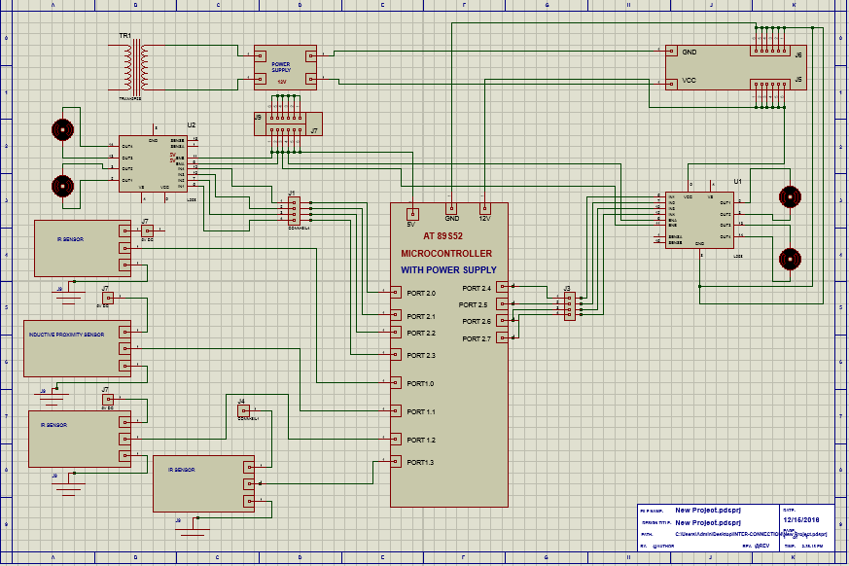
INTER CONNECTION DIAGRAM
AUTOMATIC MATERIAL SORTING MACHINE

Slide 6
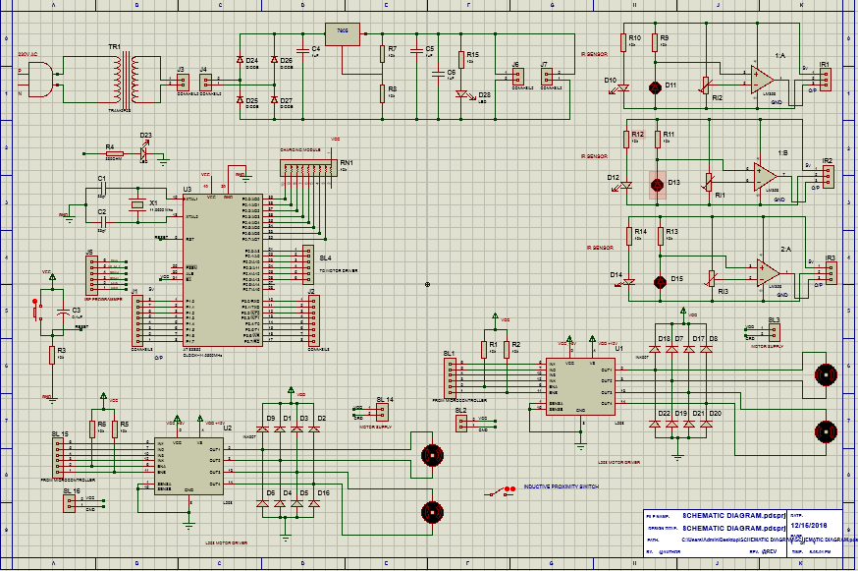
SCHEMATIC DIAGRAM
AUTOMATIC MATERIAL SORTING MACHINE

Slide 7
BLOCK DIAGRAM
AUTOMATIC MATERIAL SORTING MACHINE

Slide 8
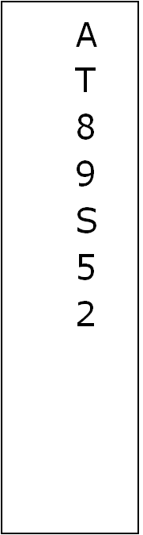
MODULE-2
MODULE-1
12V POWER SUPPLY
STEP DOWN TRANFORMER
(230VAC TO 12VAC)
MODULE-3
5V POWER SUPPLY
5V
12V
IR SENSOR
MODULE-4.0
12V
5V
DC MOTOR
5V
L298N DRIVER IC
IR SENSOR
DC MOTOR
MODULE-7.0
MODULE-4.1
5V
IR SENSOR
MODULE-4.2
DC MOTOR
5V
L298N DRIVER IC
INDUCTIVE PROXIMITY SENOSR
DC MOTOR
MODULE-6
MODULE-7.1
MODULE-5
MODULE-8

Slide 9
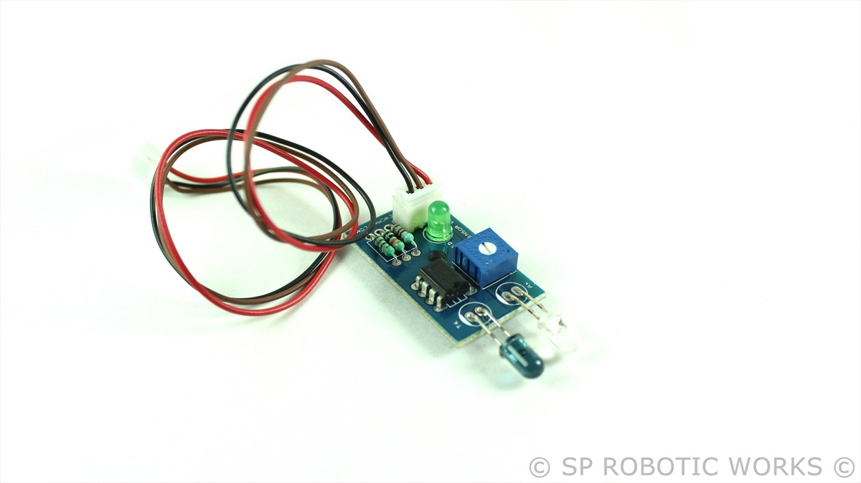
IR SENSOR
It is used to sense any object or human being.
It is small, cheap, easy to assemble.
It gives output quickly.
AUTOMATIC MATERIAL SORTING MACHINE

Slide 10
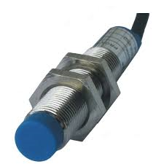
INDUCTIVE PROXIMMITY SENSOR
An inductive proximity sensor is a type of non-contact electronic proximity sensor that is used to detect the position of metal objects.
AUTOMATIC MATERIAL SORTING MACHINE

Slide 11
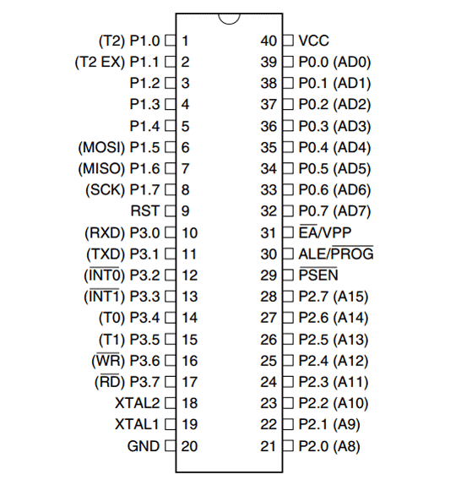
AT89S52
The ATMEL AT89s52 is 40 pins IC .
It comes under the microcontroller family.
It is an 8 bit microcontroller with 8kb of memory space.
It has ISP (in system programming) and flash memory.
It has 32 input and output pins.
It has 4 different ports each one having 8 input/output line providing a total of 32 input/output lines.
AUTOMATIC MATERIAL SORTING MACHINE

Slide 12
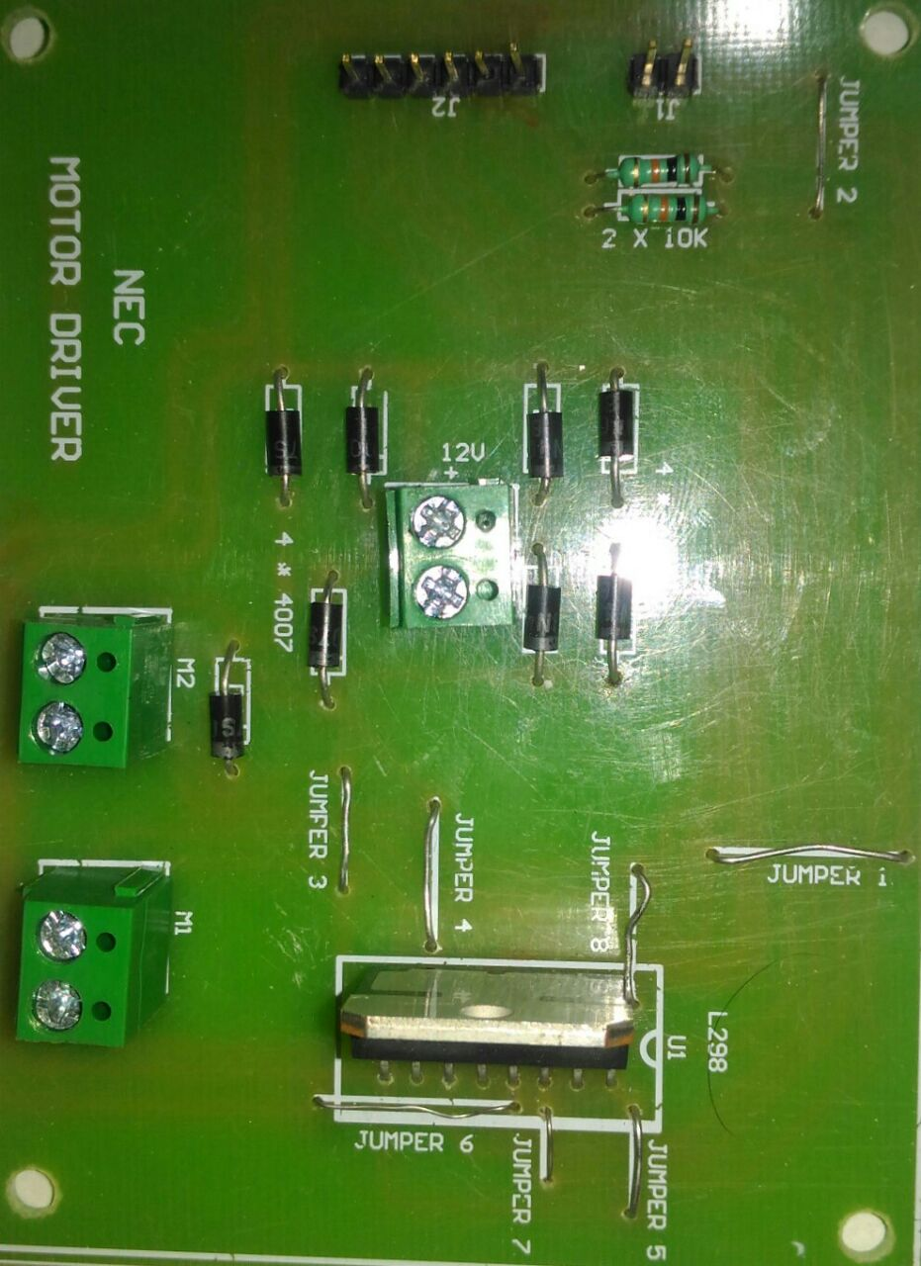
L298
It is motor driver circuit .
It can run two motor at a time.
It work as a safe guard for burning any IC
It is compulsory in every controller to run the motor.
AUTOMATIC MATERIAL SORTING MACHINE

Slide 13
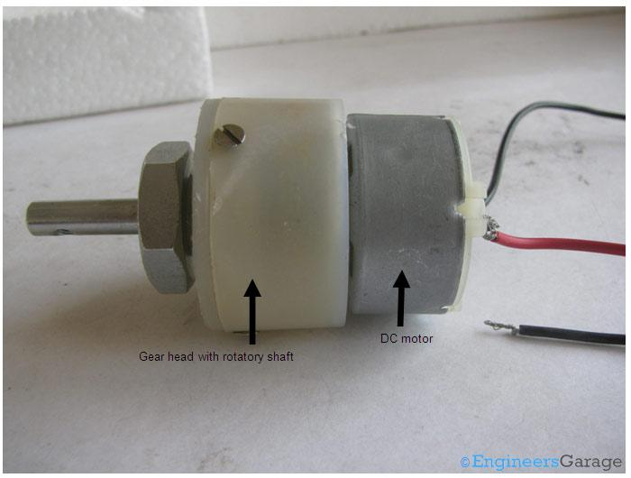
DC GEAR MOTOR
It is used to converts direct current electrical power into mechanical power.
Its having various application in small as well as large gadgets.
AUTOMATIC MATERIAL SORTING MACHINE

Slide 14
POWER SUPPLY (BLOCK DIAGRAM)
TRANSFORMER
FILTER
BRIDGE RECTIFIER
5V REGULATOR
5V
AUTOMATIC MATERIAL SORTING MACHINE

Slide 15
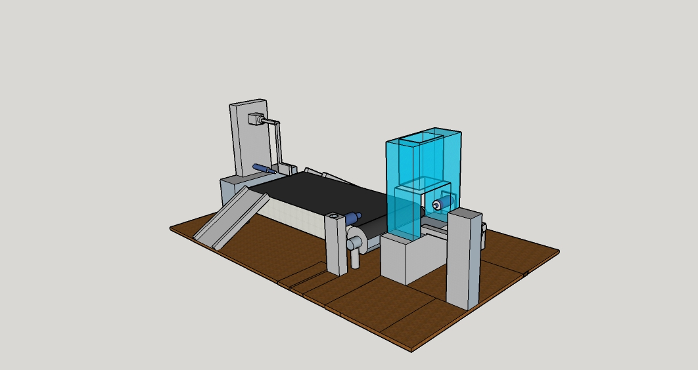
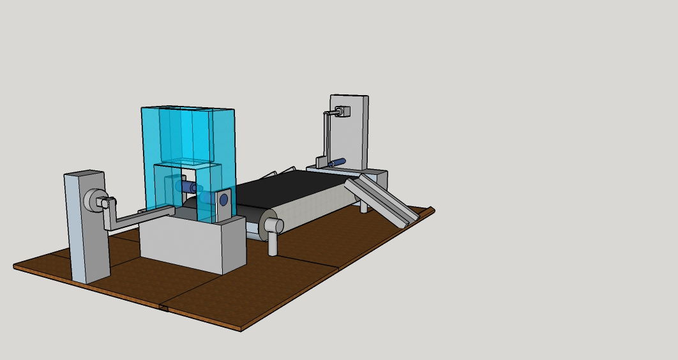
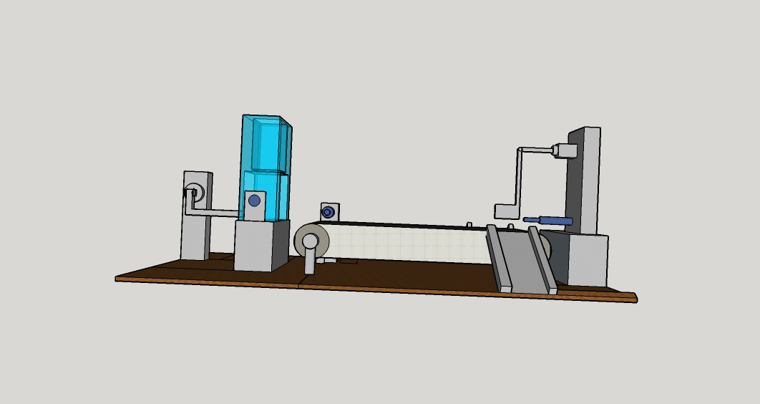
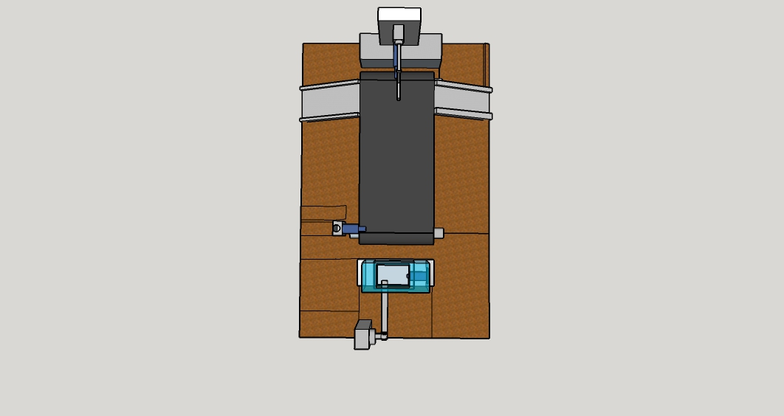
MECHANICAL DESIGN
ISOMETRIC VIEW
SIDE VIEW
FRONT VIEW
TOP VIEW
AUTOMATIC MATERIAL SORTING MACHINE

Slide 16
BILL OF MATERIAL
MECHANICAL
SL NO | ITEM DESCRIPTION | SYMBOL | QUANTITY | PRICE
1 | PLYWOOD(50CM*70CM*1CM) | _ _ | 1 | 300
2 | METAL SHEET | _ _ | 1 | 500
3 | RIVET (5mm DIA) | _ _ | 4 | 20
4 | SCREW(1INCH) | _ _ | 100gm | 30
5 | NUT& BOLT(φ 5MM, 25 MM IN LENGTH) | _ _ | 100gm | 60
6 | L- CLAMP(50MM*50MM*5MM) | _ _ | 6 | 180
AUTOMATIC MATERIAL SORTING MACHINE

Slide 17
BILL OF MATERIAL
ELECTRICAL & ELECTRONICS
SL NO | ITEM DESCRIPTION | SYMBOL | QUANTITY | PRICE
1. | DC MOTOR | 100 RPM | 2 | 120
2. | INDUCTIVE SENSOR | M12 DC inductive | 1 | 250
3 | L298 | Motor Driver | 1 | 30
4. | IR SENSOR | Silicon telecom | 1 | 35
5. | AT89S52 |  | 1 | 150
6. | CONNECTING WIRES | SINGLE STRAND | REQ | ----
AUTOMATIC MATERIAL SORTING MACHINE

Slide 18
ADVANTAGE
Cost effective
Easy to do future expansion
Reduced wastage
Reduced man power
Increased in safety
Reduce labour cost
AUTOMATIC MATERIAL SORTING MACHINE

Slide 19
APPLICATION
Manufacturing industries
AUTOMATIC MATERIAL SORTING MACHINE

Slide 20
LIMITATION
Only possible to separate block or bar type of material
AUTOMATIC MATERIAL SORTING MACHINE

Slide 21
CONCLUSION
The microcontroller, which we are using (AT89S52) we have learnt basic and working principal and difference between PIC.
This project is now completed and running successfully without any issue.
AUTOMATIC MATERIAL SORTING MACHINE

Slide 22

PROJECT VEDIO
AUTOMATIC MATERIAL SORTING MACHINE

Slide 23

Thank You
AUTOMATIC MATERIAL SORTING MACHINE

